Slide 1
UNIT I CHAPTER 1
XML

Slide 2
Introduction to XML
XML was designed to describe data.
HTML was designed to display data

Slide 3
What is XML?
• XML stands for EXtensible Markup Language
• XML is a markup language much like HTML
• XML was designed to describe data, not to display data
• XML tags are not predefined. You must define your own tags
• XML is designed to be self-descriptive
• XML is a W3C Recommendation

Slide 4
The Difference Between XML and HTML
XML is not a replacement for HTML.
XML and HTML were designed with different goals:
• XML was designed to describe data, with focus on what data is
• HTML was designed to display data, with focus on how data looks
HTML is about displaying information, while XML is about carrying information.

Slide 5
Tags in XML
With XML You Invent Your Own Tags
The tags in the example above (like <to> and <from>) are not defined in any XML standard.
These tags are "invented" by the author of the XML document.
That is because the XML language has no predefined tags.
The tags used in HTML are predefined. HTML documents can only use tags defined in the
HTML standard (like <p>, <h1>, etc.).
XML allows the author to define his/her own tags and his/her own document structure.

Slide 6
How Can XML be Used?
XML is used in many aspects of web development, often to simplify data storage and sharing
If you need to display dynamic data in your HTML document, it will take a lot of work to edit
the HTML each time the data changes.
With XML, data can be stored in separate XML files. This way you can concentrate on using
HTML/CSS for display and layout, and be sure that changes in the underlying data will not
require any changes to the HTML.
With a few lines of JavaScript code, you can read an external XML file and update the data
content of your web page.

Slide 7
XML Simplifies Data Sharing
In the real world, computer systems and databases contain data in incompatible formats.
XML data is stored in plain text format. This provides a software- and hardware-independent
way of storing data.
This makes it much easier to create data that can be shared by different applications.
XML Simplifies Data Transport
One of the most time-consuming challenges for developers is to exchange data between
incompatible systems over the Internet.
Exchanging data as XML greatly reduces this complexity, since the data can be read by different
incompatible applications.

Slide 8
XML Simplifies Platform Changes
Upgrading to new systems (hardware or software platforms), is always time consuming. Large
amounts of data must be converted and incompatible data is often lost.
XML data is stored in text format. This makes it easier to expand or upgrade to new operating
systems, new applications, or new browsers, without losing data.
XML Makes Your Data More Available
Different applications can access your data, not only in HTML pages, but also from XML data
sources.
With XML, your data can be available to all kinds of "reading machines" (Handheld computers,
voice machines, news feeds, etc.), and make it more available for blind people, or people with
other disabilities.

Slide 9
XML Tree
An Example XML Document
XML documents use a self-describing and simple syntax:
<?xml version="1.0" encoding="UTF-8"?>
<note>
<to>Tove</to>
<from>Jani</from>
<heading>Reminder</heading>

Slide 10
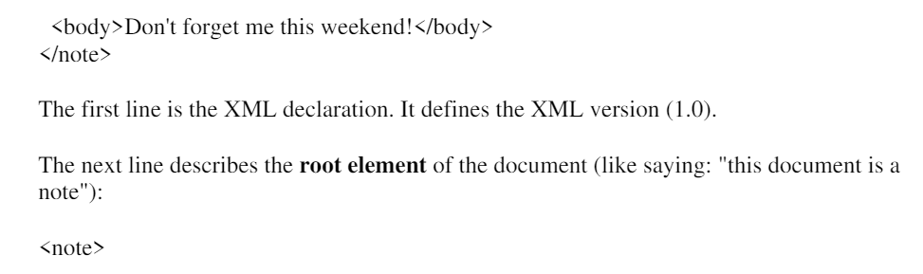
The next 4 lines describe 4 child elements of the root (to, from, heading, and body):
<to>Tove</to>
<from>Jani</from>
<heading>Reminder</heading>
<body>Don't forget me this weekend!</body>
And finally the last line defines the end of the root element:
</note>
You can assume, from this example, that the XML document contains a note to Tove from Jani.

Slide 11
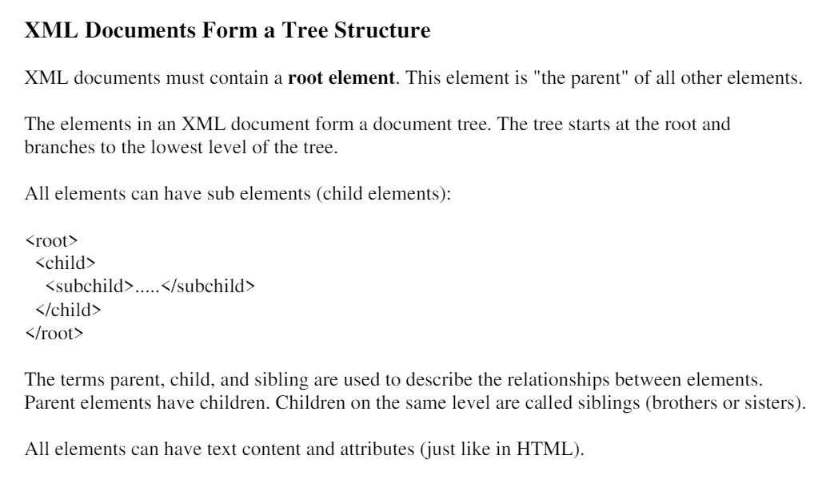

Slide 12
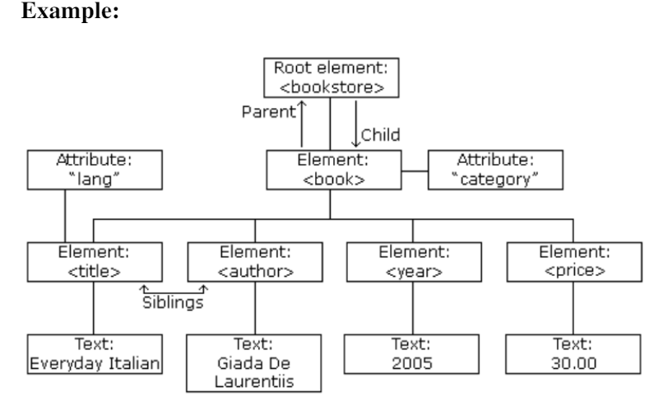

Slide 13
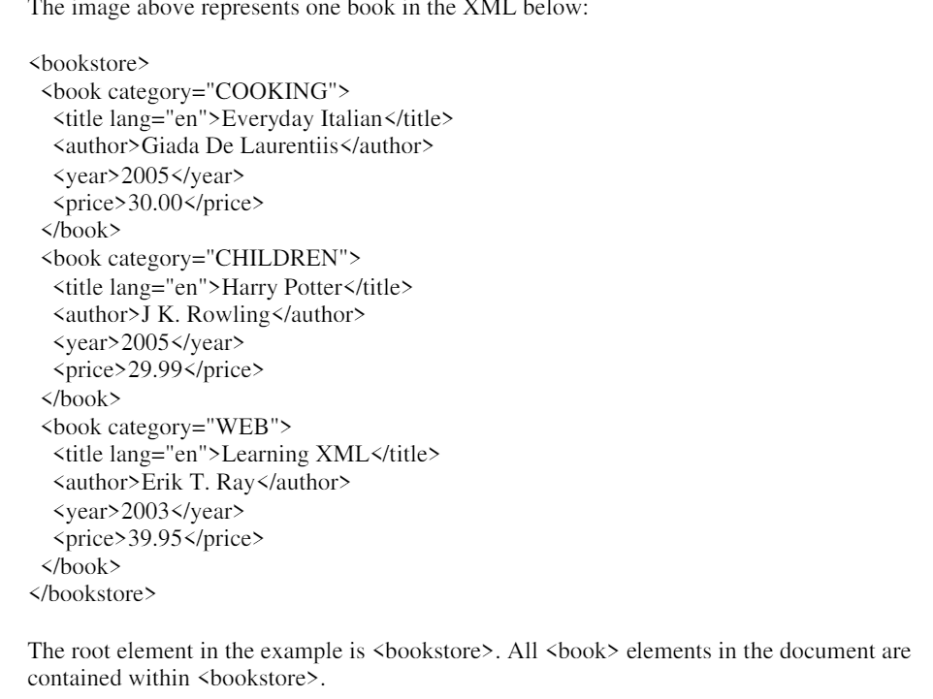

Slide 14
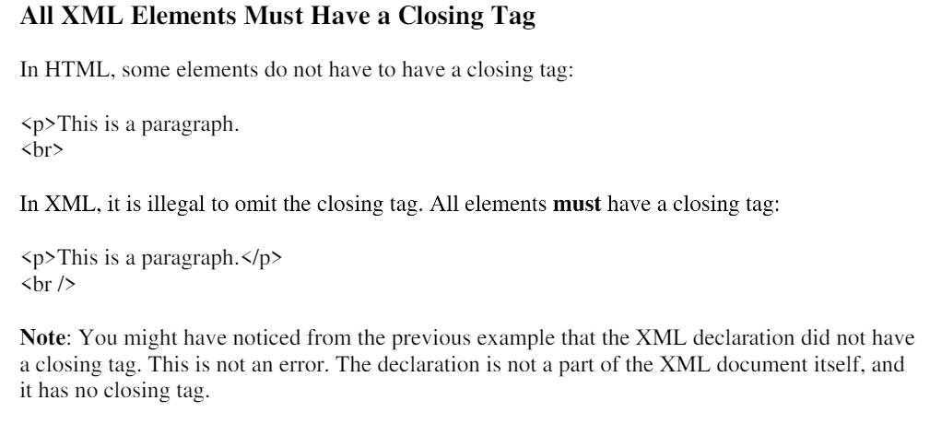
XML Syntax Rules

Slide 15
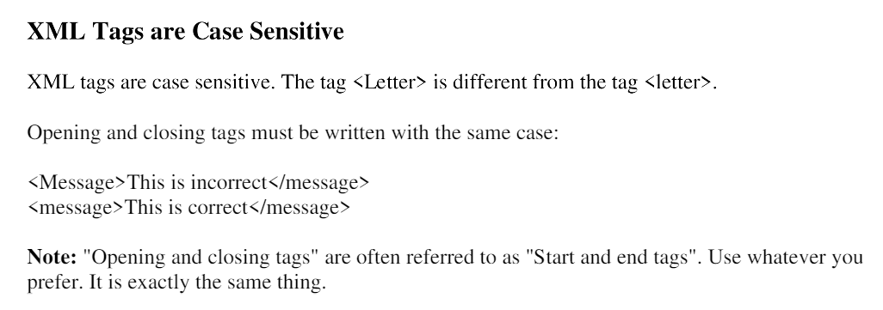

Slide 16
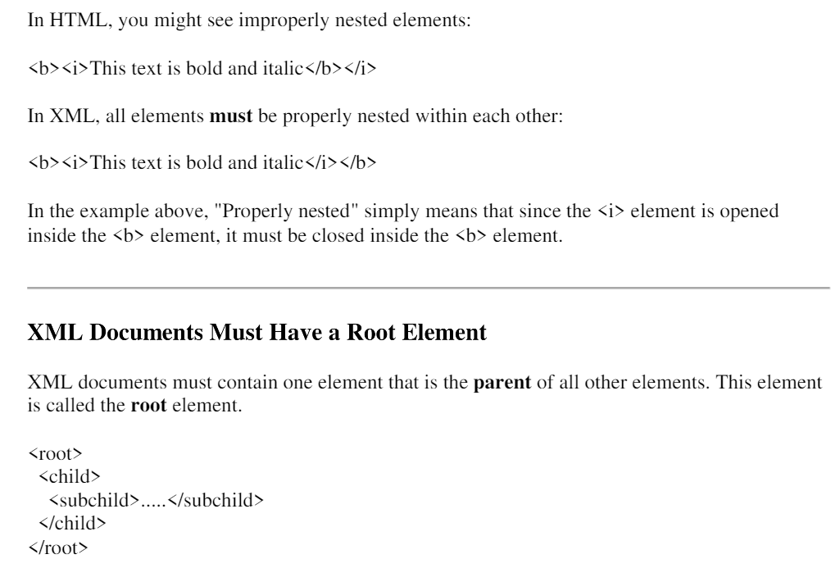

Slide 17
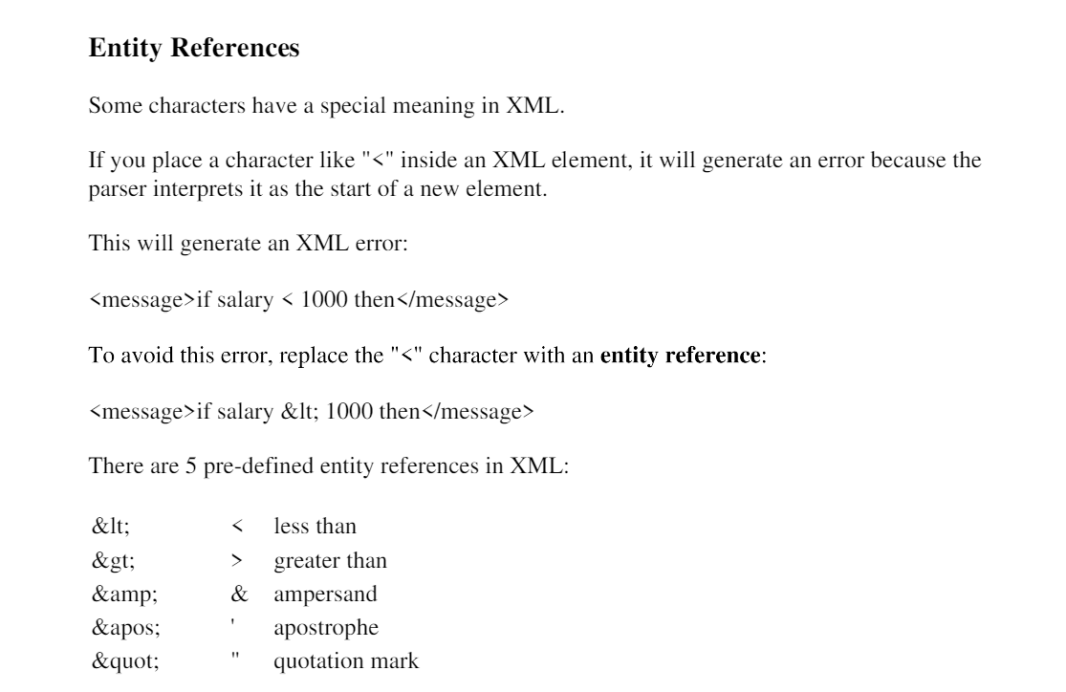

Slide 18
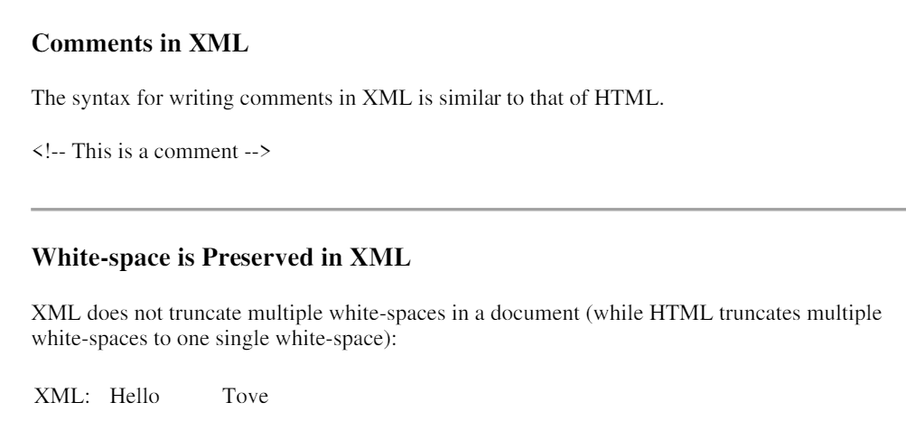

Slide 19
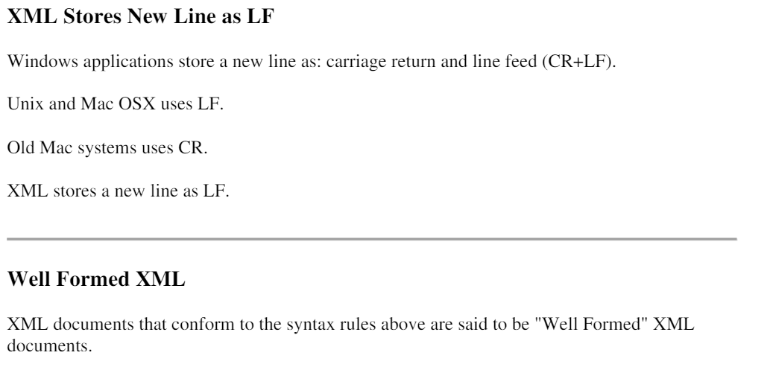

Slide 20
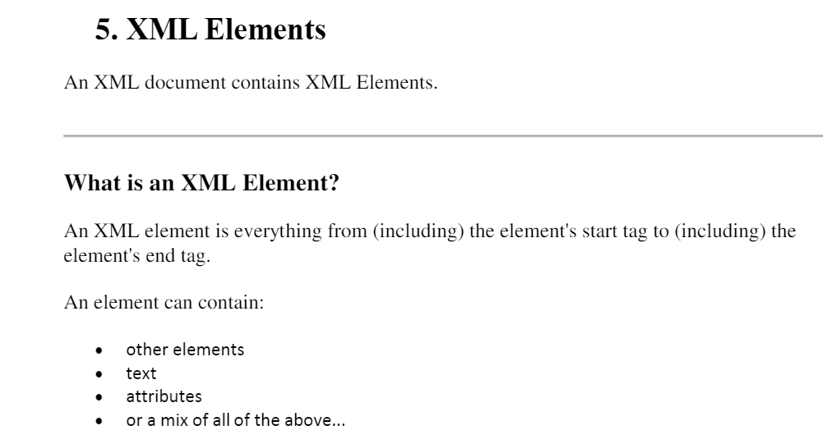

Slide 21
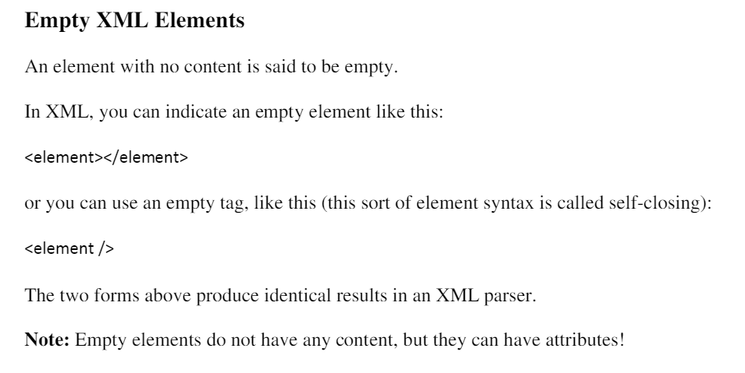

Slide 22
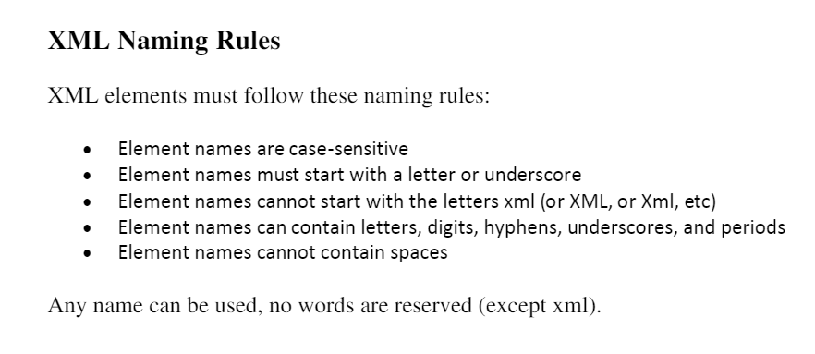

Slide 23
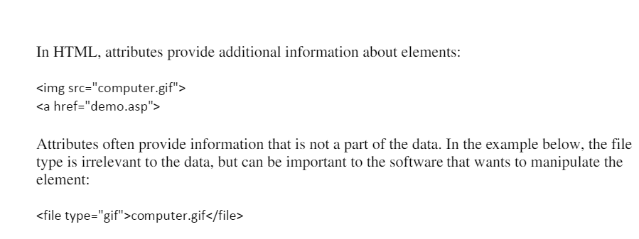
XML ATTRIBUTES

Slide 24
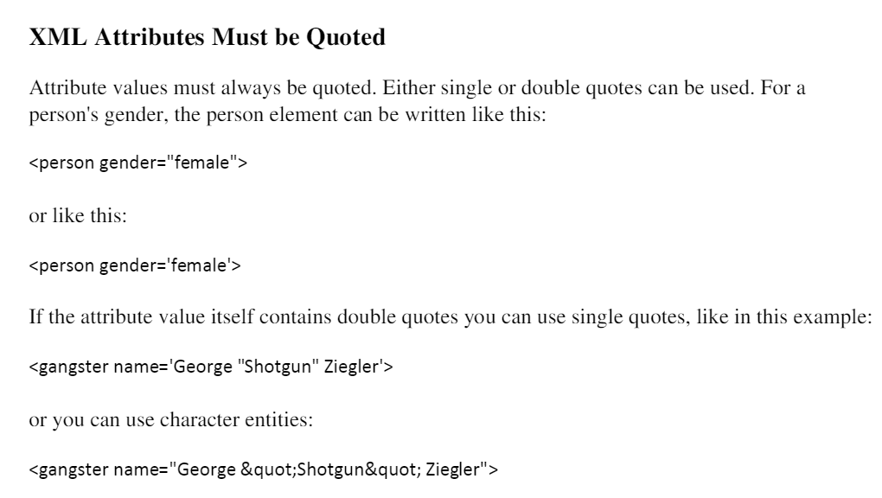

Slide 25
Bibliography : https://www.studocu.com/in/document/sree-rama-government-polytechnic-college/computer-application/introduction-to-xml-lecture-notes-1-10/22247660

